Slide 1
An Approach of Covert Communication Based on the Adaptive Steganography Scheme on Voice over IP
Yongfeng Huang;Rui Miao Department of Electronic Engineering, Tsinghua University, Beijing, China
Communications (ICC), 2011 IEEE International Conference on
Speaker:Nillson

Slide 2
Outline
Introduce
Related works
Adaptive steganography in VOIP
Experimental results and analysis
Conclusion
References

Slide 3
Introduce
This paper presents an adaptive steganography scheme that selects lower embedding bit rate in the flat blocks, while chooses higher embedding bit rate in the sharp blocks.
They design an overflow judgment to guarantee the synchronous secret data transmission.the proposed adaptive scheme outperformed the LSB and could evade RS steganalysis.
This proposed scheme is efficient, simple and can be used in real-time VoIP network with high hiding capacity.

Slide 4
Related works
DPCM: Differential PCM
ADPCM: Adaptive DPCM
M-sequence (Maximum length sequence) :
  LFSR(linear-feedback shift register)

Slide 5
Adaptive steganography in VOIP
The model of covert communication based on VoIP
Embedding algorithm
  Block division rule
  Adaptive embedding scheme based on the smoothness of the block.
  Overflow judgment
Retrieving algorithm

Slide 6
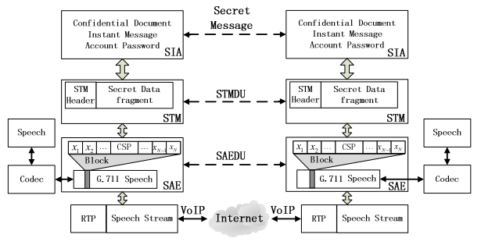
Adaptive steganography in VOIP(cont.)
The model of covert communication based on VoIP

Slide 7
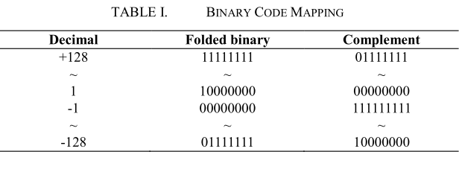
Adaptive steganography in VOIP(cont.)
Embedding algorithm
  Block division rule

Slide 8

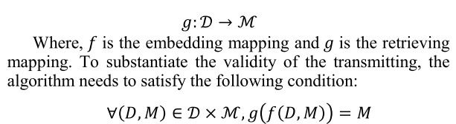
Adaptive steganography in VOIP(cont.)
Embedding algorithm
  Adaptive embedding scheme based on the smoothness of the block.

Slide 9
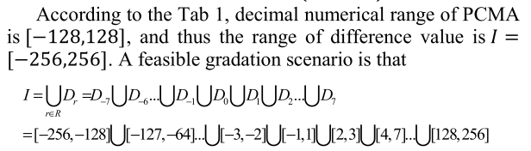
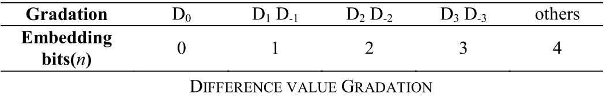
Adaptive steganography in VOIP(cont.)
Embedding algorithm
  Adaptive embedding scheme based on the smoothness of the block.

Slide 10
Adaptive steganography in VOIP(cont.)
Retrieving algorithm
  According to the same principles and the identical parameters as the embedding algorithm, when the sample value is no overflow, the embedded secret message can be retrieved synchronously

Slide 11
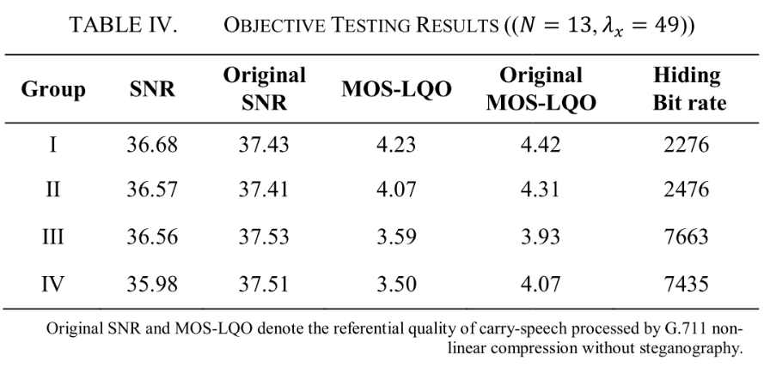
Experimental results and analysis
Objective Testing for the Speech Quality
  Overall Test

Slide 12
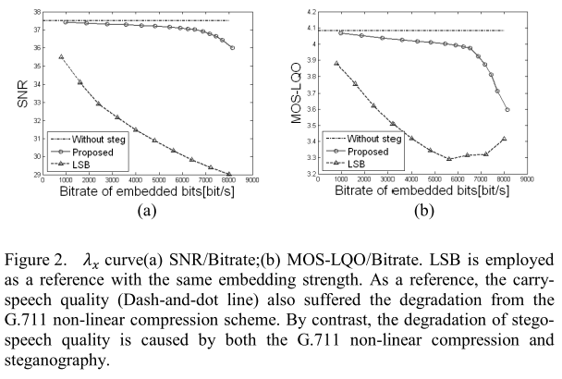
Experimental results and analysis(cont.)
Objective Testing for the Speech Quality
  Characteristic curve of

Slide 13
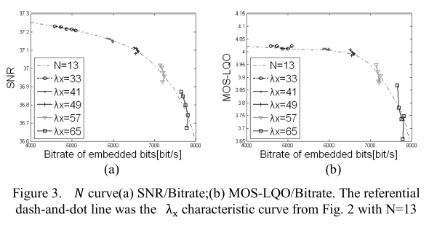
Experimental results and analysis(cont.)
Objective Testing for the Speech Quality
  Characteristic curve of N

Slide 14
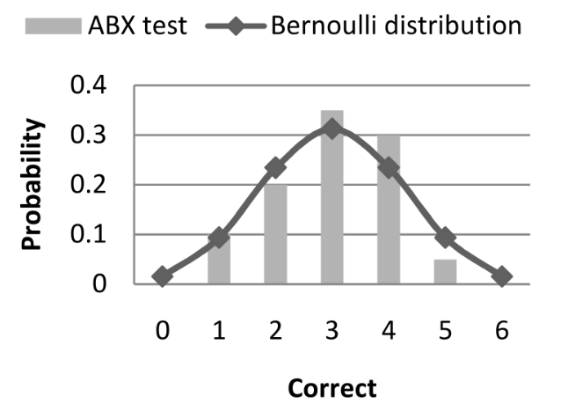
Experimental results and analysis(cont.)
Subjective Testing based ABX method

Slide 15
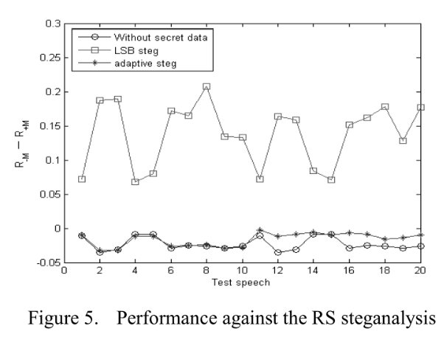
Experimental results and analysis(cont.)
Performance against the RS Steganalysis

Slide 16
Conclusion
adopting an adaptive steganography scheme to embed different size of secret data in speech stream according to the smoothness of speech block.
Compared with LSB method at the same hiding capacity, our proposed scheme could achieve much better speech quality,revealing the sufficient capacity and superior security.Specifically, around 7.5 kbps of secret information could be embedded while the degradation of the MOS-LQO value is less than 0.5.
Besides, compared with the vulnerable security of LSB method, They proposed method could substantially evade the current steganalysis like RS detection.
Depending on required application background, the proposed algorithm determines the tradeoff between the embedding capacity and the degradation of speech quality by selecting the appropriate parameters of block length, and the overflow threshold.

Slide 17
References
ADPCM
  http://eager.pixnet.net/blog/post/670161-%5B%E8%BD%89%E9%8C%84%5Dadpcm
M-sequence
  http://zh.wikipedia.org/wiki/M-sequence
B. Xiao, Y. Huang."Modeling an optimizing of the information hiding communication system over streaming media,"Journal of Xidian University, Chinese, 2008, Vol35,University, Chinese, 2008, Vol3

